Slide 1
Harmonic Conjugates
(And lots of circles)
(Because we really like circles)
Math Club 12/05/2011
Free Powerpoint Templates

Slide 2
First Problem: Apollonius’s Problem
Your ship at point A is chasing a ship on point B.
Their ship is travelling in some direction at constant speed in a line.
Your ship is k times faster than their ship.
Your ship must also sail in a straight line at constant speed.
Which way should you go?

Slide 3
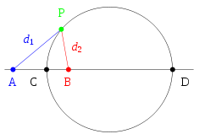
Second Problem: What is a circle?
Καὶ παντὶ κέντρῳ καὶ διαστήματι κύκλον γράφεσθαι (a circle is defined by a center and a radius) – Euclid’s Third Postulate
Given A and B and a ratio k, a circle is the set of points P such that $\frac{PA}{PB}=k$ – Apollonius

Slide 4
Harmonic Conjugates
Is it possible to divide a line segment internally and externally in the same ratio?
Here, let’s say that $\frac{AC}{BC}=\frac{AD}{BD}$.
We say C and D divide AB harmonically.
Then notice that $\frac{BC}{BD}=\frac{AC}{AD}$.
So A and B divide CD harmonically as well.
AB and CD are harmonic conjugates.

Slide 5
Constructing Harmonic Conjugates (1)
We have points A and B fixed, and have in mind some number k.
We want a point P such that AP is k times BP.
Draw a circle of any length around B.
Then draw a circle k times as long around A.
Their intersection is a suitable P, if they intersect.

Slide 6
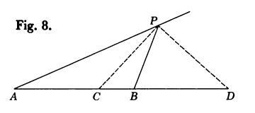
Constructing Harmonic Conjugates (2)
We have a point P now.
Draw the internal bisector of P and let C be the intersection with AB.
Draw the external bisector of P and let D be the intersection.
AB and CD are harmonic conjugates!

Slide 7
Constructing Harmonic Conjugates (3)
Now does this actually work?
By the angle bisector theorem, $\frac{AC}{BC}=\frac{AP}{BP}=k$.
By the external angle bisector theorem, $\frac{AD}{BD}=\frac{AP}{BP}=k$.
Hence $\frac{AC}{BC}=\frac{AD}{BD}=k$.
So AB and CD are harmonic conjugates!

Slide 8
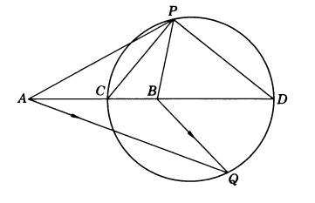
Constructing the Circle of Apollonius
$\frac{AC}{BC}=\frac{AD}{BD}=k$
Notice that P is not part of this, so this works no matter what P we choose.
Also notice that CPD is a right angle.
Then P has to lie on the circle with diameter CD!

Slide 9
Apollonius, we solved your problem
Which direction do we need to go?
Knowing AB, we construct the harmonic conjugates CD
Then we draw the circle with diameter CD
We know their direction, so they are going to intersect the circle at some point, say Q.
We just sail towards Q!

